Slide 1
AUDIENCE SURVEY
Notes:
Use Franklin Gothic Medium for Title slide/ White font colour

Slide 2
How Soon Will People Return?
Q: After social distancing restrictions are lifted, how soon will you be comfortable going to a movie theatre, hotel. Restaurant and bar?

Slide 3
How Soon Will People Return?
Q: After social distancing restrictions are lifted, how soon will you be comfortable going to a performing arts venue?

Slide 4
Desired Safety Measures
Respondents wanted to see the following safety measures upon returning:
Masks
Social Distancing
Capacity Limits
No-touch ticket scanning
Hand-sanitizing stations
Q: What sort of precautions would you want to see in place if you were to attend a live indoor performance?

Slide 5
Preference by Age
Younger demographics are much more likely to return sooner. Respondents over the age of 25 show little variation by age group.
Note that there were very few respondents <18 years, so these were bundled with 18 – 24 age group.
Q: Time before being comfortable attending event at large venue

Slide 6
Respondent Previous Habits
Those who have attended events more frequently in the past year are more likely to return sooner than those who have not.
Q: Before COVID-19 how frequently did you visit the Confederation Centre?

Slide 7
Online Acceptance
Q: Knowing the performers and crew were getting paid for their work, how much would you be willing to spend to view a live or taped performance online?

Slide 8
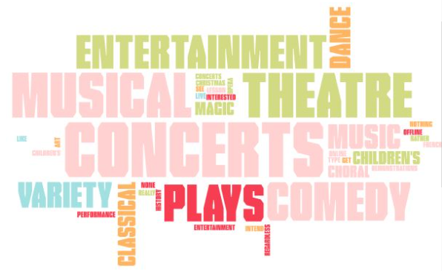
Online Content
Q: What length of performance would you be most likely to view online?

Slide 9
Who Responded?
2074
Total
Respondents

